Slide 1
Artistic Style Transfer
for Videos
Seri Choi and Nithin Buduma

Slide 2
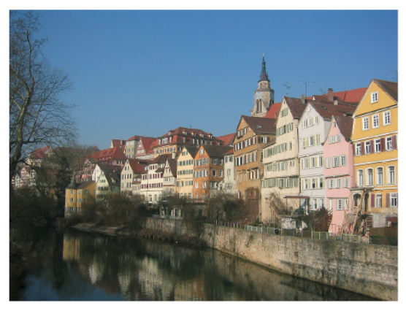
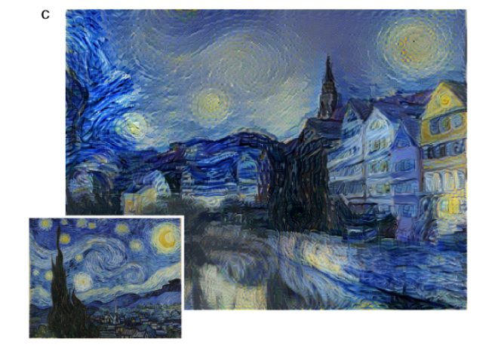
Style Transfer
The Starry Night, 1889 by Vincent van Gogh
Members: Seri Choi and Nithin Buduma

Slide 3
Motivation/Overview
Natural extension to videos
Experiment with multiple styles
Took a neural-net based approach
Converted frames, stitched into video
Members: Seri Choi and Nithin Buduma

Slide 4
Approach/Method
Square size
Varied num_steps
Linear vs Logistic
Varied k
Members: Seri Choi and Nithin Buduma

Slide 5
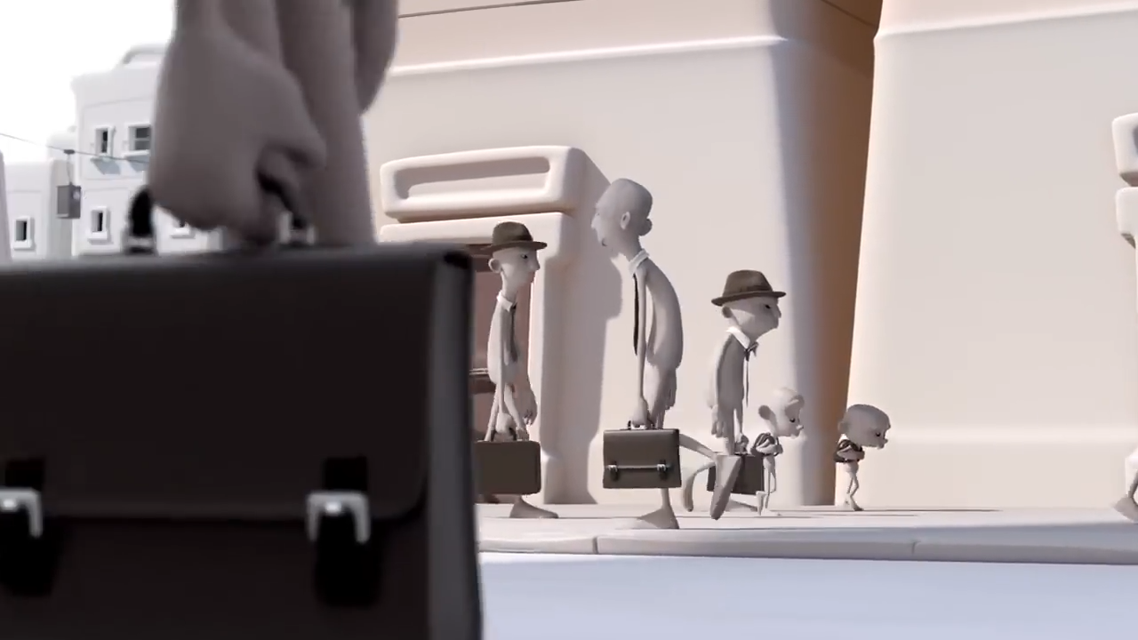
Original Video
Members: Seri Choi and Nithin Buduma

Slide 6
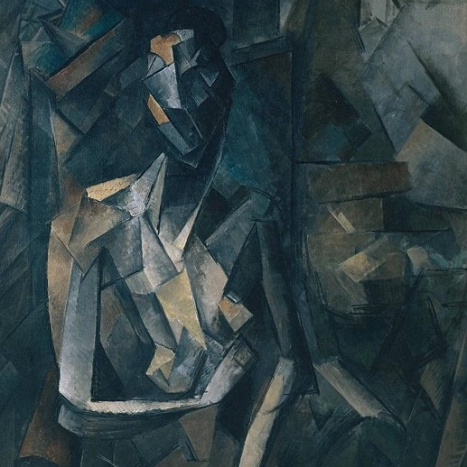
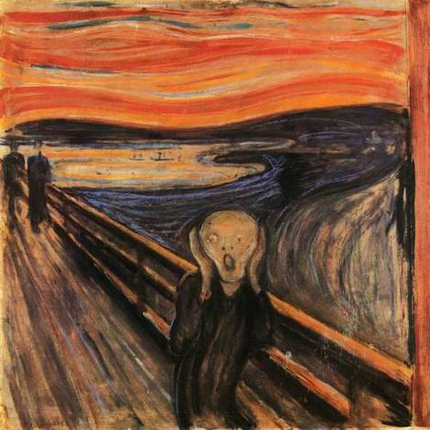
Style Images
Seated Nude, 1909 by Picasso
The Scream, 1893 by Edvard Munch
Members: Seri Choi and Nithin Buduma

Slide 7
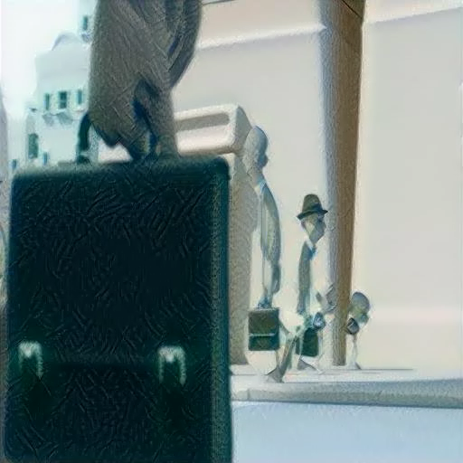

Approach/Method Continued
Linear, num_steps = 25
Logistic, num_steps = 25
Members: Seri Choi and Nithin Buduma

Slide 8
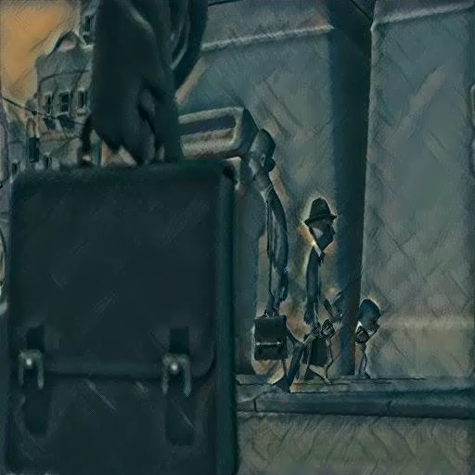
Results Video
Members: Seri Choi and Nithin Buduma

Slide 9
Conclusion/Further plan
Preserve the input size
Color mapping
Stability by adding noise
Members: Seri Choi and Nithin Buduma

